Slide 1
The Research Computing Center
Nicholas Labello
labello@uchicago.edu

Slide 2
Advance research and scholarship at the University of Chicago by providing research computing resources, support, education, training, and advanced technologies.
Office of the Vice President for Research and for National Laboratories
Research Development (Arete)
University Research Administration (URA)
Research Computing Center (RCC)
Center for Technology Development and Ventures (UChicago Tech)

Slide 3
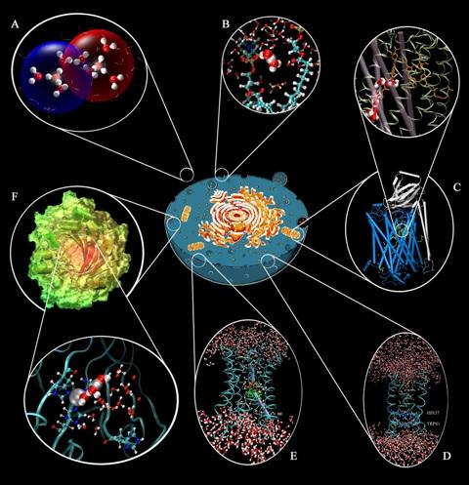






UChicago
4 major graduate divisions: (1) Physical Sciences, (2) Biological Sciences, (3) Social Sciences, (4) Humanities
8 major schools (Booth, Pritzker, SSA)
More than 140 institutes and centers
Enrico Fermi Institute
Institute for
Biophysical Dynamics
Institute for Molecular Engineering
Kavli Institute for Cosmological Physics
Notes:
A wide array of research disciplines with various computation and data management needs
All programs and services influenced by diversity of research
can’t focus on specific domains
complexity must be hid; simple enough to be used by the smallest users that are just exploring computing for the first time

Slide 4
UChicago
Astronomy & Astrophysics
Biochemistry & Molecular Biology
Chemistry
Chicago Booth, Instruction & Research
Computational Institute
Computer Science
Ecology & Evolutionary Biology
Economics
Enrico Fermi Institute
Geophysical Sciences
Health Studies
Linguistics
Mathematics
Medicine
Molecular Engineering, Institute for
Organismal Biology & Anatomy
Pediatrics
Physics
Psychiatry and Behavioral Neuroscience
Psychology
Radiation & Cellular Oncology
Radiology
Statistics
An array of research disciplines with widely varying computation and data management needs

Slide 5
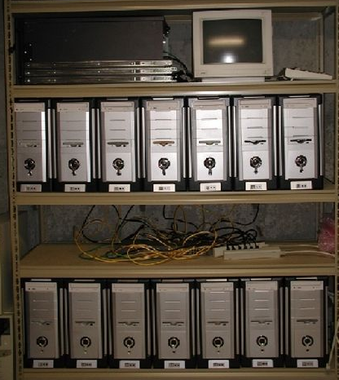
What issues are researchers facing?
Lack of data management know-how
Complexity of computing/storage hardware
Ad hoc solutions
Poor performance, excessive cost
Data Archiving
Study Concept
Data Collection
Data Processing
Data Distribution
Data Discovery
Data Analysis
Repurposing
Notes:
A collaborative digital environment where peers can work together; a home for project data
The ability to meet federal data management requirements
easy data sharing
Storage and compute managed by someone else (professional)
Technical support, user support, training
be a one-stop-shop that Minimize research computing barrier-to-entry
all researchers should be able to access the HPC infrastructure, store data, and run jobs at no cost
Enable small-scale users to have a good experience
Shield small users

Slide 6
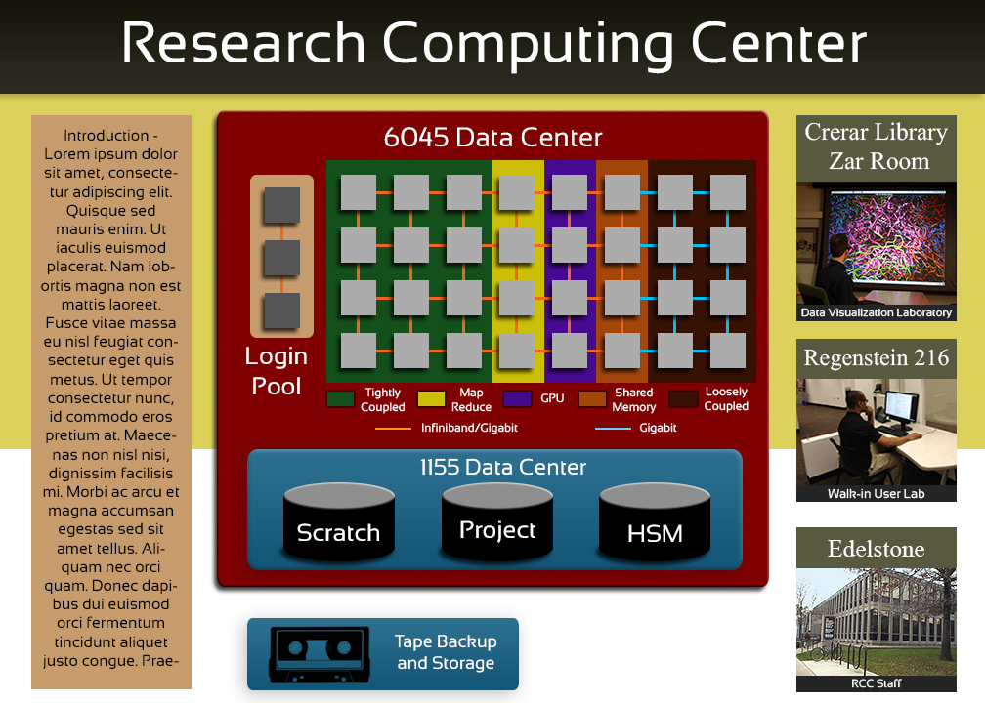
Storage
Notes:
- difference compute pools and storage pools, networks, location

Slide 7
Programs and Services
Campus Resource Allocations
Cluster Partnership
Special CPP: Cluster Management
Computing Tools
Consultant Partnership
Workshops and Training
Education
Outreach
New Faculty Support
Grant Support (letter of commit, data management)
Notes:
what programs can we build?

Slide 8
Research Account Requests
Notes:
Excluding education, special, staff, students,
Principal Investigator
A PI is a member of the academic staff or faculty who bears responsibility for the intellectual leadership of a project. A PI-account permits a principal investigator to manage resources such as cpu-hours, project storage, and users.
General User
A general user account must be associated with an existing PI account. These accounts allow users to access resources allocated to principal investigators.

Slide 9
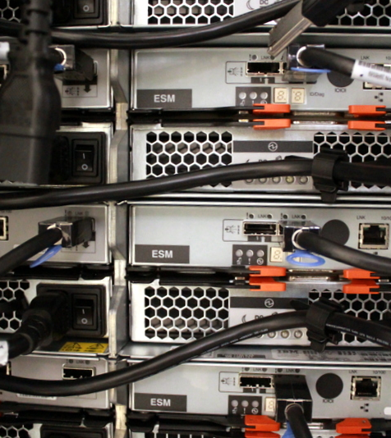
Cluster Partnership Program
Allows researchers to augment RCC HPC and storage infrastructure
Tightly-coupled nodes
Loosely-coupled nodes
GPU accelerators
Shared memory nodes
High performance storage
Capacity storage
Tape backup
Partner hardware is similar to the hardware of the RCC cluster
Contact info@rcc.uchicago.edu for system requests with requirements outside the RCC CPP
Notes:
Nodes share the same basic architecture, allowing management to be straightforward
CPP incentives
Heavy discount compared to true cost of running the nodes
- bulk purchase prices (RCC secures prices upfront)
no cost for system administrators and basic user support, and our system admins are better than their grad students
No need to buy shared infrastructure (login nodes, management nodes, storage nodes, home directory space, high performance scratch,
Quiet replacement of failed hardware

Slide 10

Faculty Support
Assistance in the recruitment process
Early access to RCC resources and help transitioning to UChicago
Evaluation and acquisition of hardware
Commitments to funding agency
Data management plans
Notes:
Describes research computing services available to all faculty
Advise on the compute and related costs for start up funds
assists with the evaluation and acquisition of new compute resources.
guides new faculty through account creation
assists with file transfers
assists with porting applications and software installations.
provides access to RCC compute resources prior to moving to UChicago.
Provides free training to members of the research group

Slide 11

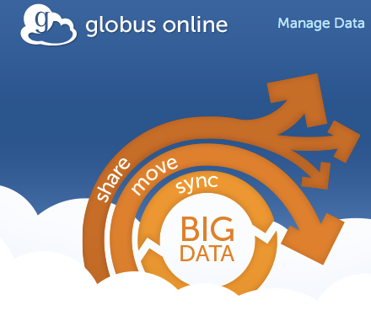
Development of Computing Tools
Fast easy parallel scripting - on multicores, clusters, clouds and supercomputers
Secure, reliable, high-performance data transfer
Access to distributed high throughput computing resources
Notes:
Distinguishing because as part of supporting “research computing” we also have to support the teams developing tools, not just scientific applications. Computing itself is the focus, not means to an end as w/ science projects

Slide 12
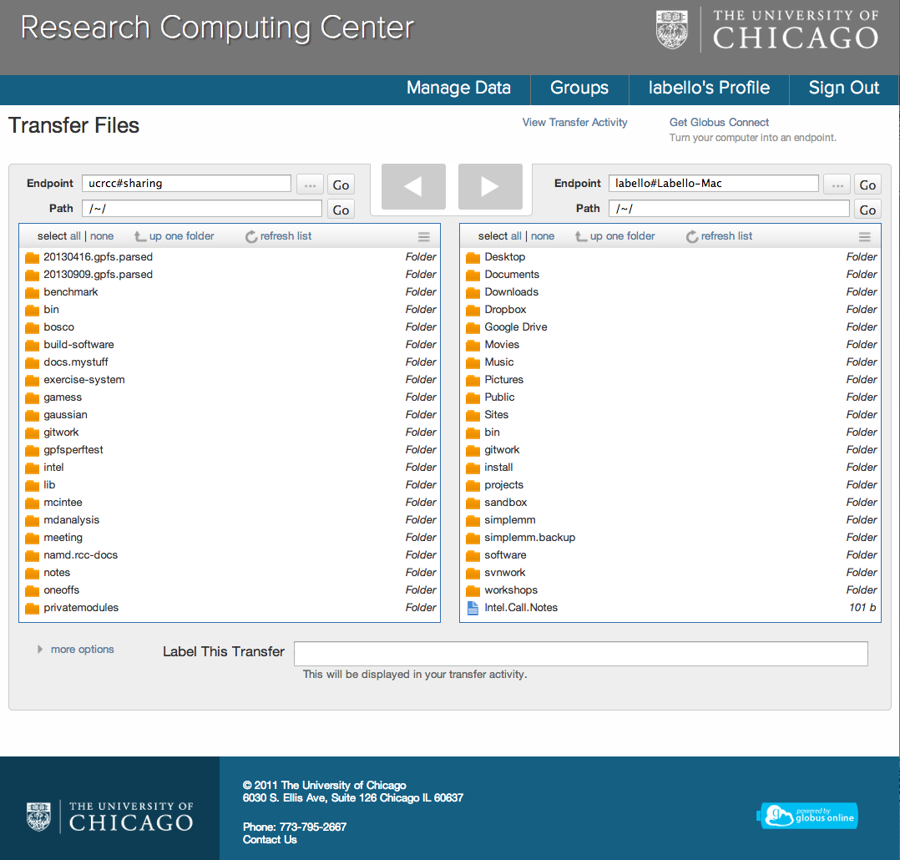
Globus Online RCC Implementation
Use UChicago authentication
Available with each RCC account
Easy install of Globus Connect
Branded/Site entry
Stats/monitoring of RCC use

Slide 13
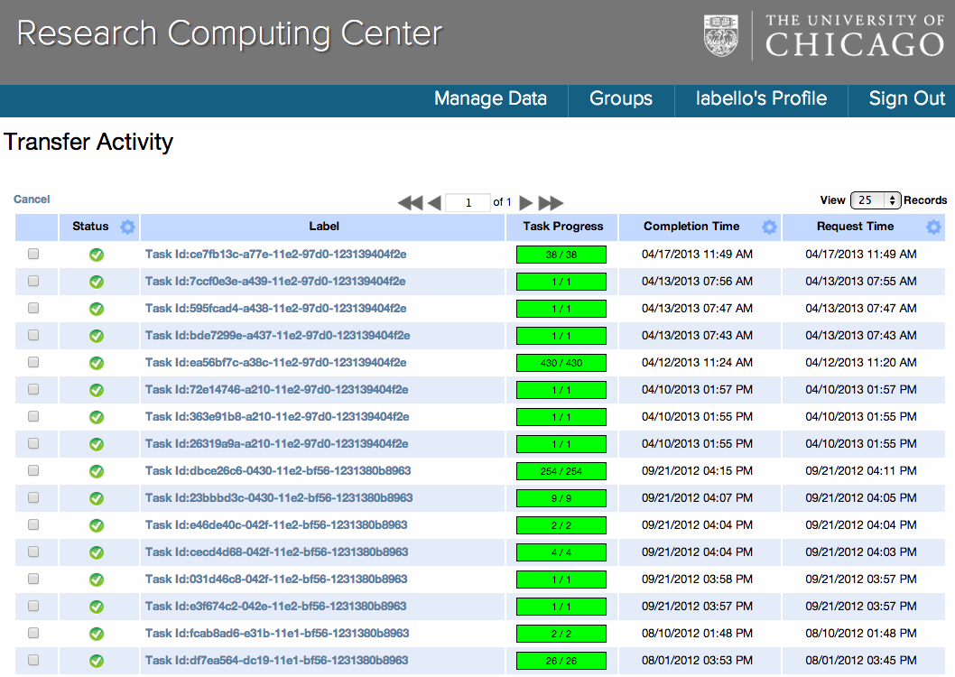

Slide 14
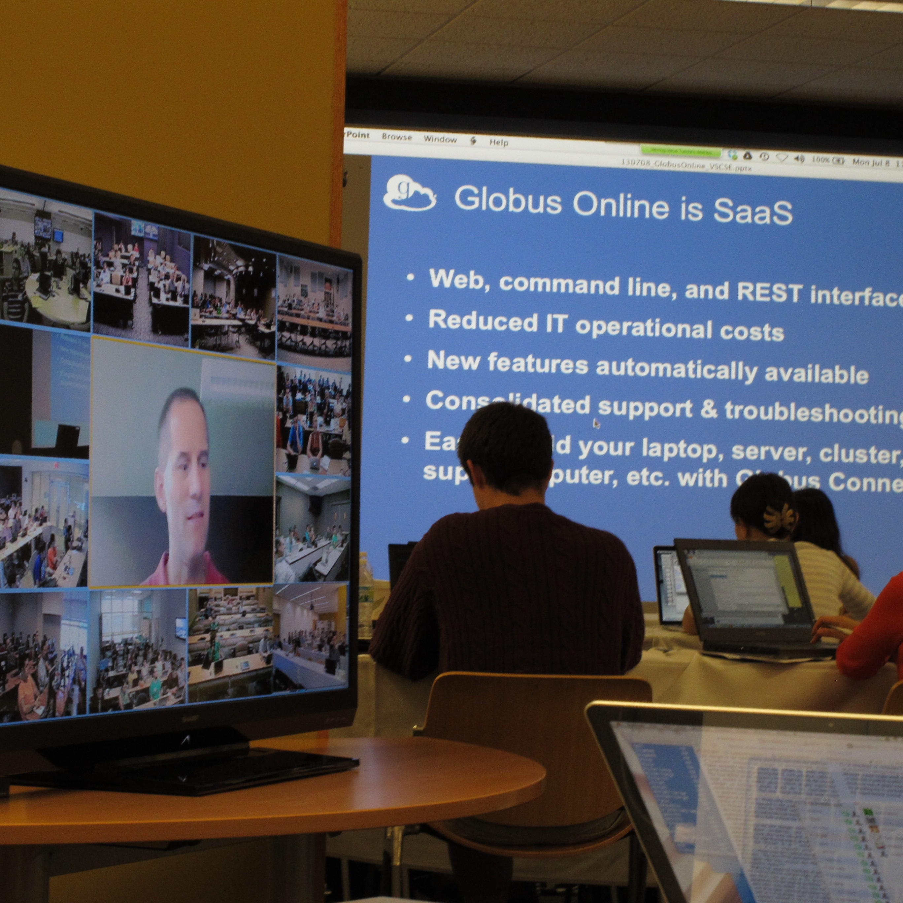
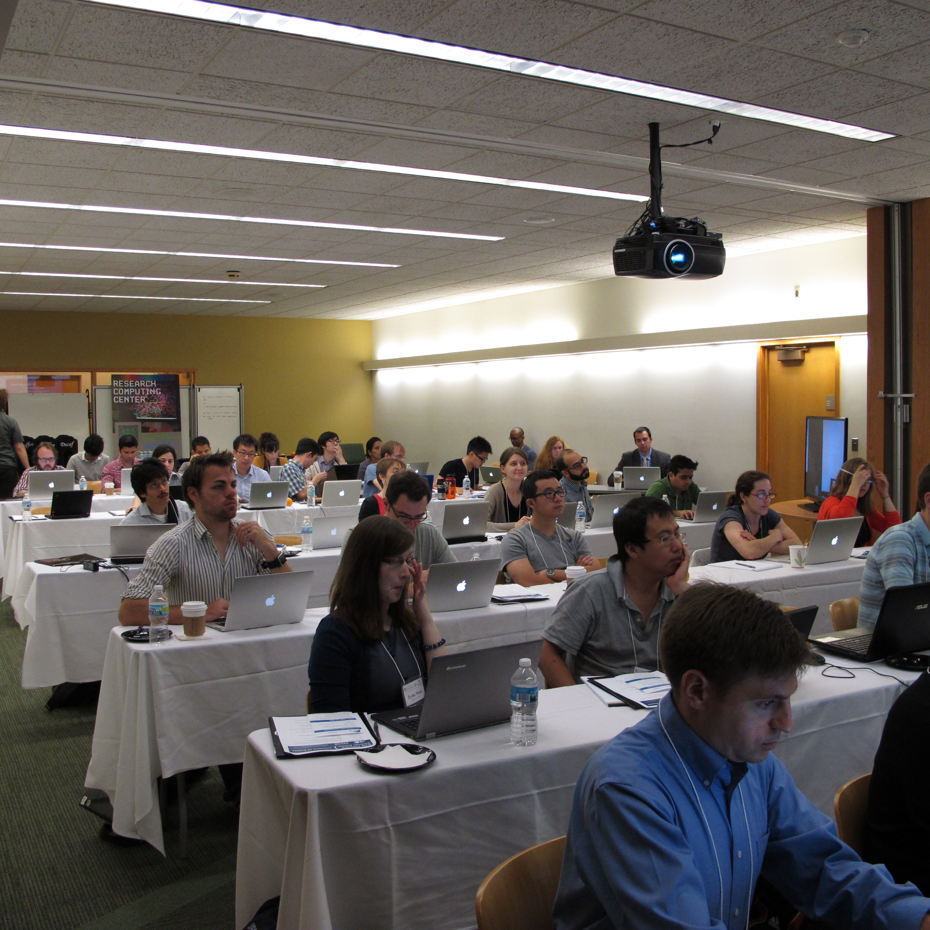
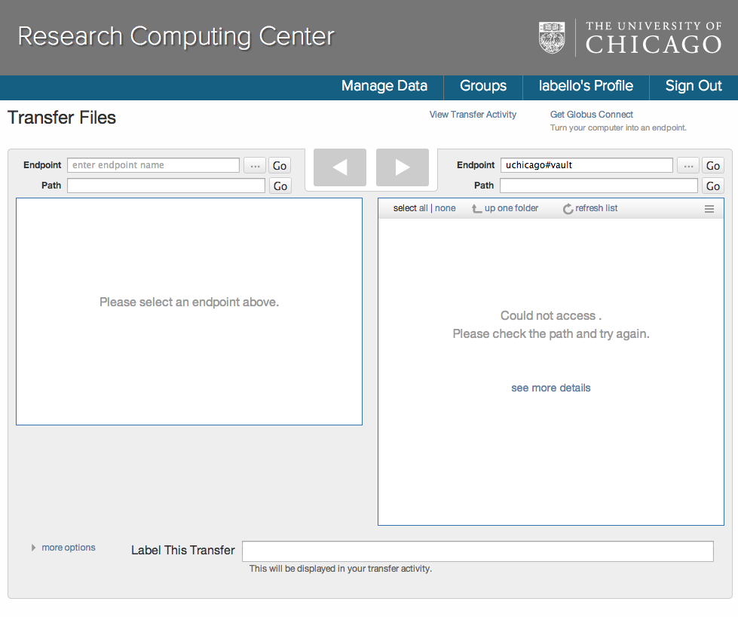
Notes:
RCC site used as globus exemplar
15 sites
~500 participants
Virtual School for Computational Science and Engineering

Slide 15
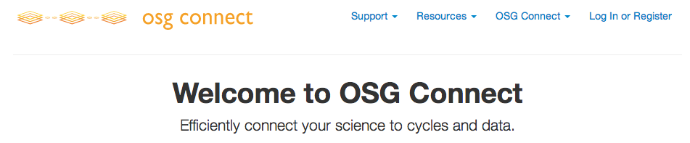
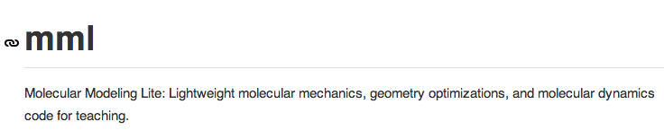
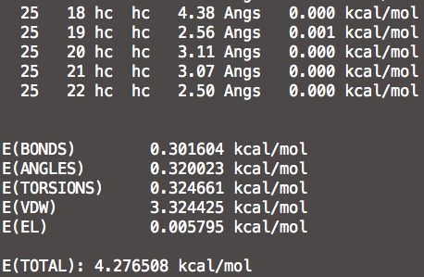
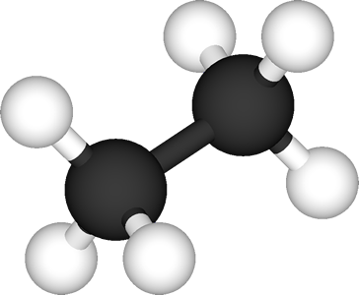
OSG Connect
Notes:
mml = good fit for high throughput job (python)

Slide 16
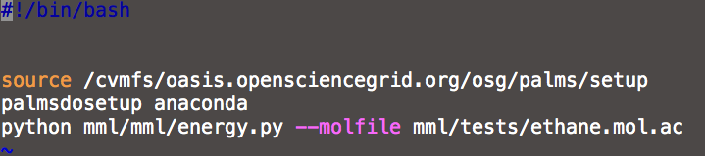
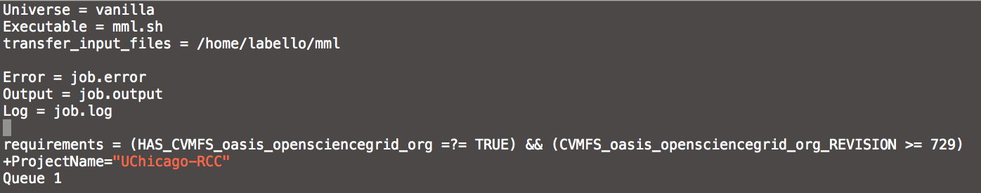
No local software installation
cNet authentication (Local cluster, Globus, email)
Leverage global application software stack (palms/oasis)
Time to first job submission measured in minutes
Executable
Submit

Slide 17
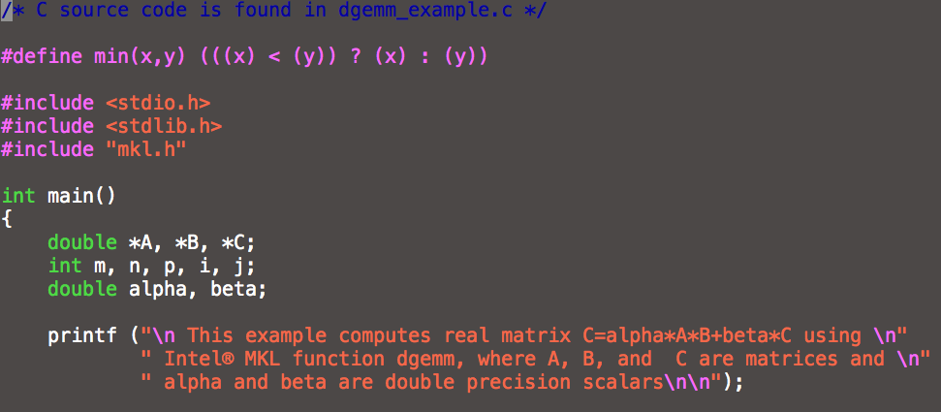
proprietary compiler
Intel Math Kernel Library (MKL)
icc -mkl –static eg.c

Slide 18
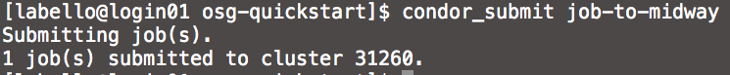
From osgconnect to Midway
Notes:
non-opportunistic ?

Slide 19
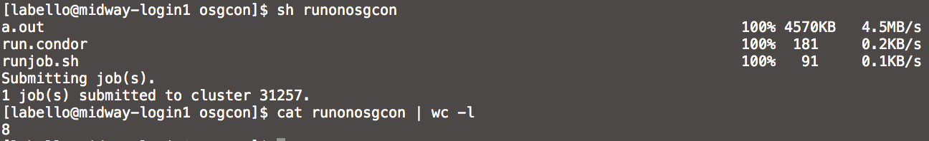
1. From Midway (local resource)
2. Submit job to OSGConnect
Notes:
What was accomplished
- Run my Python code (not some canned test)
- Build C code with proprietary compiler and math library on external machine, run
- Submit to my resources
Submit from my resources
No new account creation, no software installation

Slide 20
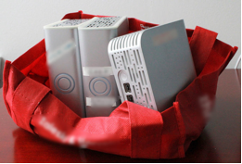
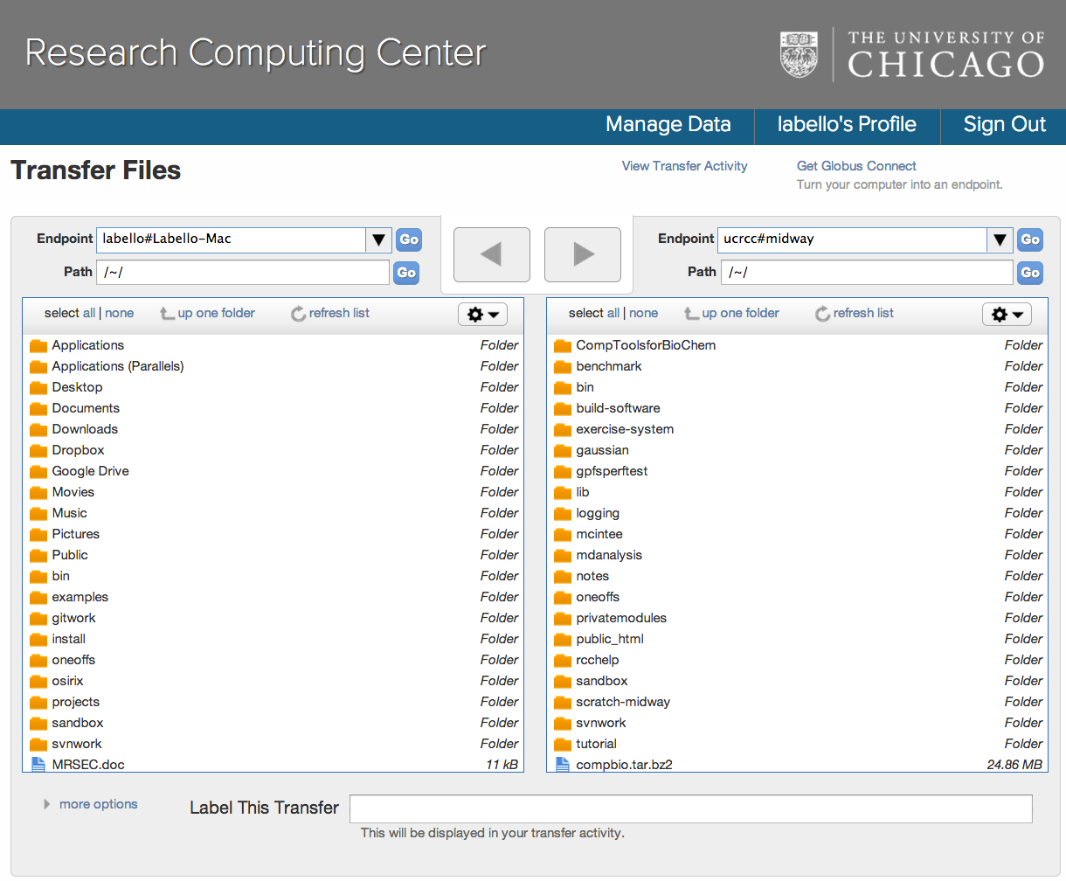
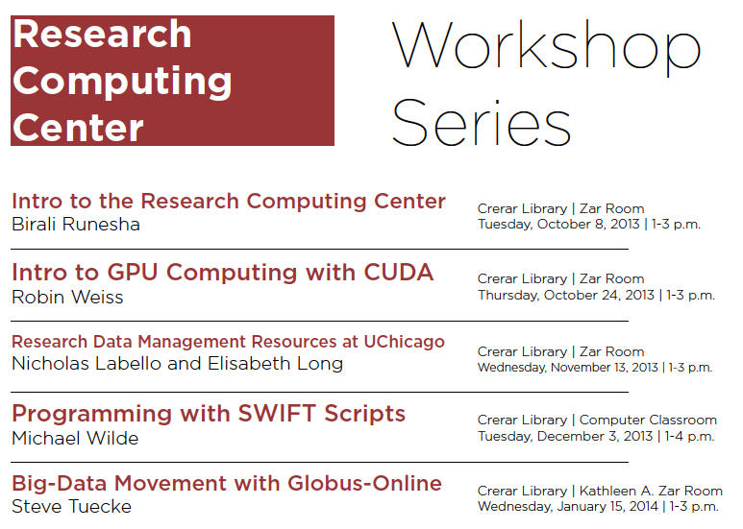
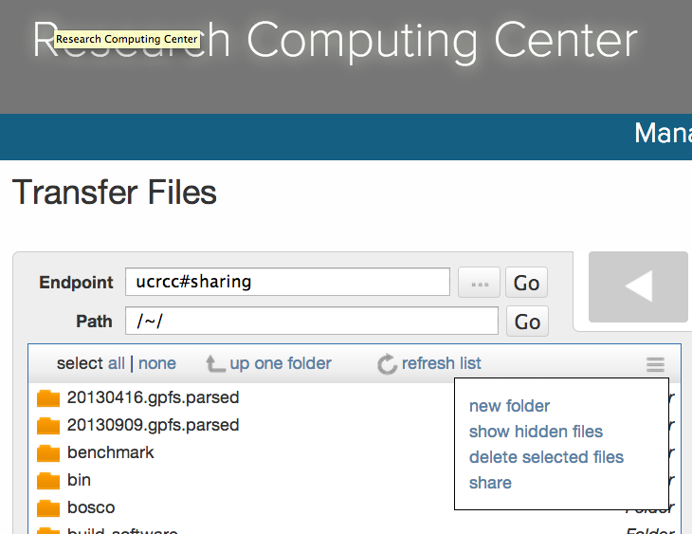
Internal Evaluation
Identify need and use cases
Determine appropriate implementation
Training & community
Beta testing new features

Slide 21
?

